Slide 1
Types of Virtualization
MR NGOSA GATHAMS

Slide 2
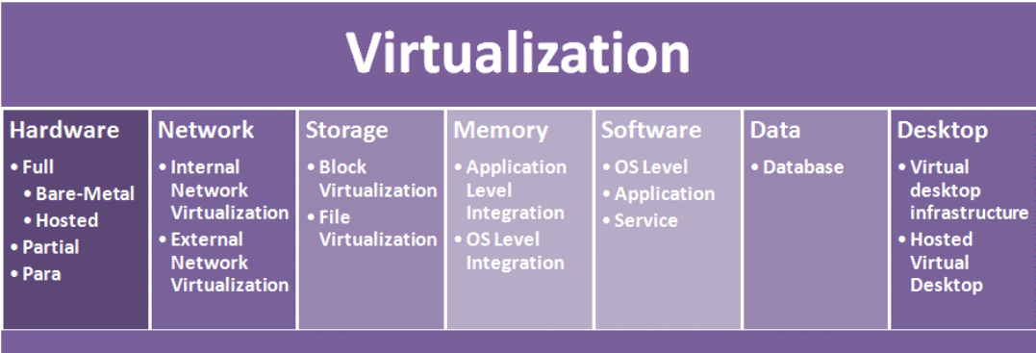
Major Types of
Dr. Neeraj Kumar Pandey

Slide 3
Types of Hardware virtualization
Hardware virtualization is further subdivided into the following types:
Full Virtualization – In it, the complete simulation of the actual hardware takes place to allow software to run an
unmodified guest OS.
Para Virtualization – In this type of virtualization, software unmodified runs in modified OS as a separate system.
Partial Virtualization – In this type of hardware virtualization, the software may need modification to run.
Dr. Neeraj Kumar Pandey

Slide 4
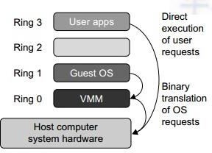
FULL VIRTUALIZATION
Dr. Neeraj Kumar Pandey

Slide 5
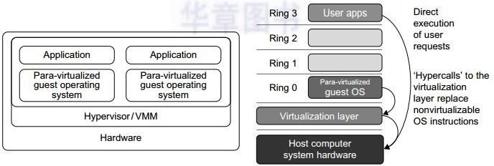
PARA VIRTUALIZATION
Dr. Neeraj Kumar Pandey

Slide 6
Network Virtualization
Internal Network Virtualization: It refers to the management and monitoring of a computer network as a single managerial entity from a single software­based administrator’s console. It is intended to allow network optimization of data transfer rates, scalability,reliability, flexibility, and security. It also automates many network administrative tasks. Network virtualization is specifically useful for networks experiencing a huge, rapid, and unpredictable increase of usage.
External Network Virtualization: Combine many networks, or parts of networks into a virtual unit. External Network Virtualization involves and actual physical device that caters to your network. This type of virtualization has been around for some time now, a typical example of this would be a CISCO networking switch that provides VLAN (virtual LAN) capabilities through its internal CISCO iOS software.
Dr. Neeraj Kumar Pandey

Slide 7
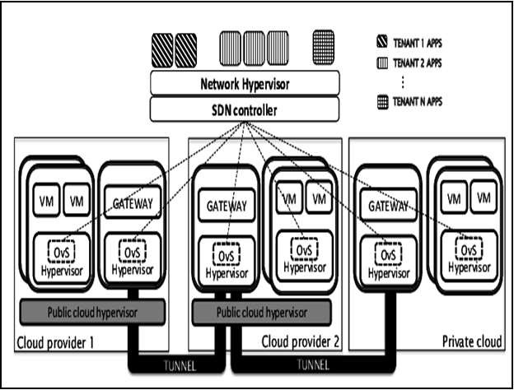
Dr. Neeraj Kumar Pandey

Slide 8
Storage Virtualization
In this type of virtualization, multiple network storage resources are present as a single storage device for easier and more efficient management of these resources. It provides various advantages as follows:
Improved storage management in a heterogeneous IT environment
Easy updates, better availability
Reduced downtime
Better storage utilization
Automated management
In general, there are two types of storage virtualization:
Block virtualization ­ It works before the file system exists. It replaces controllers and takes over at the disk level.
File virtualization ­ The server that uses the storage must have software installed on it in order to enable file­level usage.
Dr. Neeraj Kumar Pandey

Slide 9
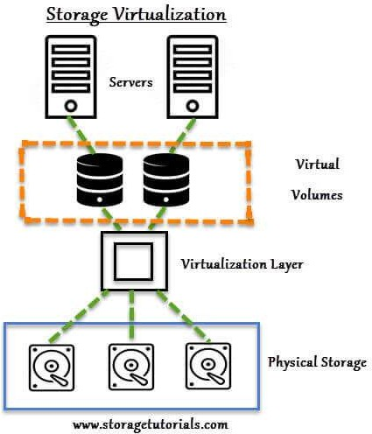
Dr. Neeraj Kumar Pandey

Slide 10
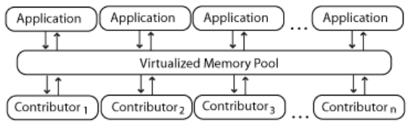
Memory Virtualization
It introduces a way to decouple memory from the server to provide a shared, distributed or networked function. It enhances performance by providing greater memory capacity without any addition to the main memory. That’s why a portion of the disk drive serves as an extension of the main memory.
Application level integration – Applications running on connected computers directly connect to the memory
pool through an API or the file system.
Dr. Neeraj Kumar Pandey

Slide 11
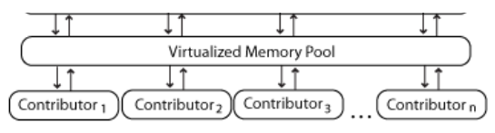
Memory Virtualization…
Operating System Level Integration – The operating system first connects to the memory pool, and makes
that pooled memory available to applications.
Dr. Neeraj Kumar Pandey

Slide 12
Software Virtualization
It provides the ability to the main computer to run and create one or more virtual environments. It is used to enable a
complete computer system in order to allow a guest OS to run. For instance letting Linux to run as a guest that is
natively running a Microsoft Windows OS (or vice versa, running Windows as a guest on Linux)
Types:
Operating system
Application virtualization
Service virtualization
Dr. Neeraj Kumar Pandey

Slide 13
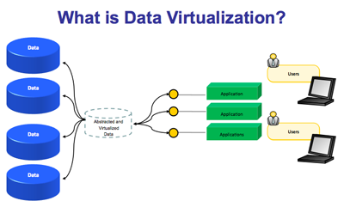
Data Virtualization
Without any technical details, you can easily manipulate data and know how it is formatted or where it is physically
located. It decreases the data errors and workload.
Dr. Neeraj Kumar Pandey

Slide 14
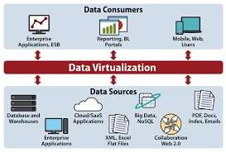
Dr. Neeraj Kumar Pandey

Slide 15
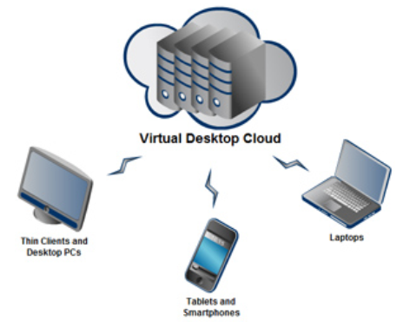
Desktop virtualization
It provides the work convenience and security. As one can access remotely, you are able to work from any location and on any PC. It provides a lot of flexibility for employees to work from home or on the go. It also protects confidential data from being lost or stolen by keeping it safe on central servers.
Dr. Neeraj Kumar Pandey

